Slide 1
Company X Communications Plan
Constance S. Ward Thought Leader Zone

Slide 2
Campaign Ideas

Slide 3
Campaign Theme
When the brand splits into two segments, it’s necessary to build that awareness with a theme that would work internally and externally and in the wide range of languages used at Company X
One potential theme is “Same & Different”
Same – as a commodity brand with an emphasis on being LIKE other competitors in the field
Different – as a solutions brand with a focus on delivering value-added products/services that are UNLIKE other competitors in the field

Slide 4
Campaign Theme
“Same & Different” can be the mantra for the internal and external campaigns, too
Potential campaign imagery is pictured below, where the XXX and the YYY could be
words that are Same (XXX) & Different (YYY), like the word “solutions”
pictures that convey the message that change leaves some things the Same & some Different, like a photo of a remaining product & additional products or like a photo of the CEO in winter & in summer or as a child & as an adult
XXX & YYY

Slide 5
External Campaign Theme
Same – emphasize to customers and other stakeholders what will not change, whether they interact with Company X as a commodity or a solutions brand, such as quality and responsiveness to customer needs
Different – emphasize what differentiates Company X’s value-added products and services from the past and from others, such as innovative offerings

Slide 6
Sample External Campaign Tactics
Conduct a sales training meeting to ensure that marketing and sales force employees are fully briefed internally so that they have a clear idea of what’s is/isn’t changing and can convey that message externally
Look for opportunities to involve “not the usual suspects” in reaching out to their counterparts in the customers’ organization, such as Company X's HR head meeting with Customer X’s HR leader or Company X's communications team members having a lunch meeting with Customer Y’s communications team to zipper better with the customers

Slide 7
Internal Campaign Theme
Same – emphasize to employees what will not change to reassure them that the rug isn’t being pulled out from under them
Different – emphasize what changes will affect them, how and when
Use humor if possible to drive home the “Same & Different” message, such as a contest on the intranet with employee photos to see who is least- or most-changed

Slide 8
Sample Internal Campaign Tactics
Launch a Take 10 and a Take 2 program
Take 10 – ask each employee to have a coffee and spend 10 minutes reading the information about the changes on the intranet, portal, etc.
Take 2 – ask a select group of influential employees to invite 2 people to an apero/coffee with the stipulation that each invitee must then take 2 more people for coffee and so on
Hang Same & Different posters with strong visuals (like the HSBC campaign where they show, for example, a couple camping on two side-by-side posters, one of which says “exciting” and the other “boring”)

Slide 9
Some Sample Tools

Slide 10
Sample Message Triangle for Company X
XX
XX
Same & Different
XX
Notes:
Make them short, broad and sound-bites

Slide 11
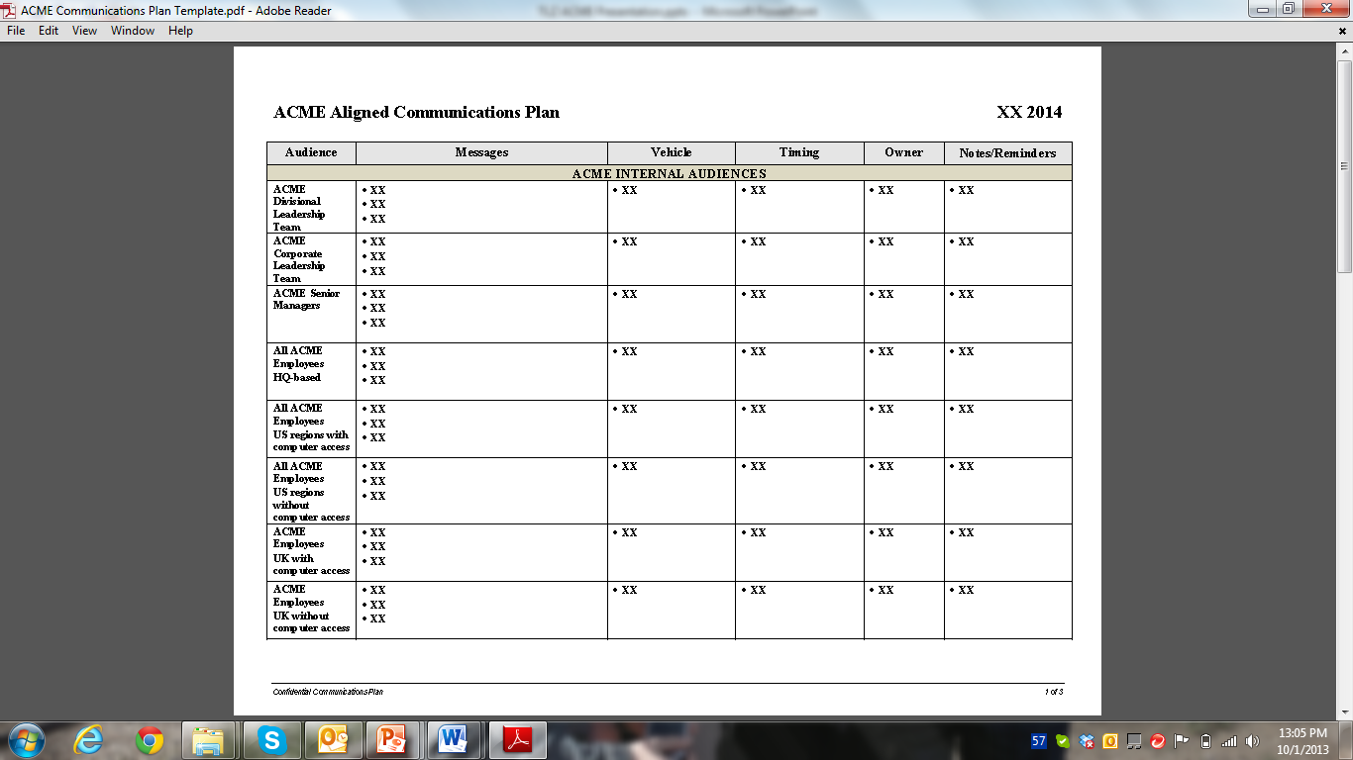
Sample Communications Plan for Company X

